Slide 1
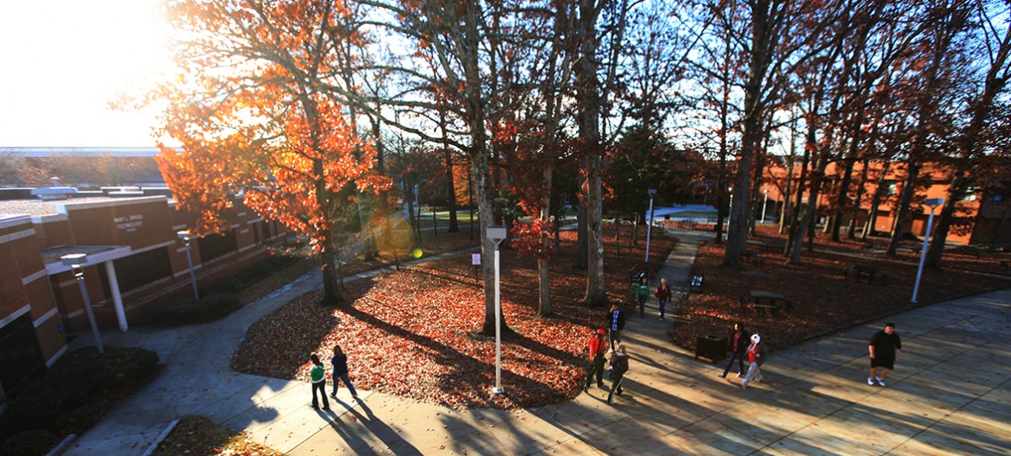
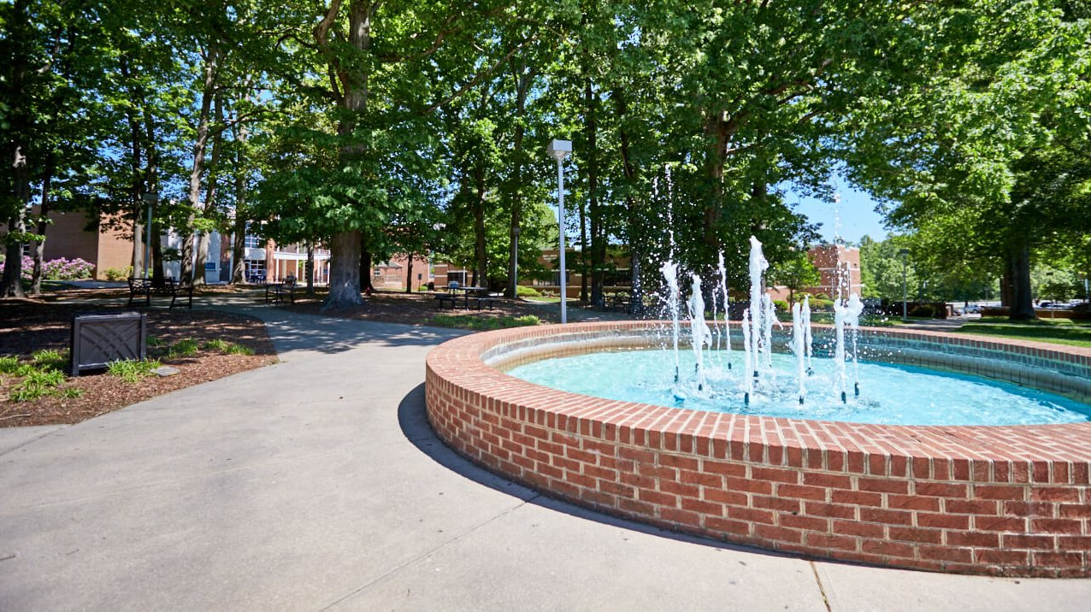
Discover Davidson-Davie Community College!

Slide 2
Agenda
Welcome!
Campus information
College and Career Readiness
Adult HS/GED/Transition Center
Applying to Davidson-Davie
Application, FAFSA, Orientation
Q&A

Slide 3
Fast Facts
Formerly Davidson County Community College (DCCC) until January 2021→ Davidson-Davie Community College
Locations: Davidson Campus, Davie Campus, Uptown Lexington Education Center, Thomasville Education Center, Davie Education Center, online
Student Body: ~ 5,000 enrollment each semester
40+ curriculum, certificate, degree programs
Entry terms: Fall 1&2, Spring 1&2, Summer
Numerous demand-driven Short-Term/ConEd Courses
Student engagement: 30+ clubs/organizations, 4 Varsity Athletic programs (NJCAA Division 2)

Slide 4
Why Davidson-Davie?
Flexible schedule
Academic flexibility, school-life balance, online options
Smaller class sizes
20 students on average, friendly & caring faculty, hands-on learning, personalized attention
Strong STEM, workforce, & certificate programs
Career development embedded into curriculum
Dual enrollment for Davidson and Davie students
Free tuition, graduate high school with your Associate’s
Smooth transition to a 4-year institution
Existing transfer agreements (NC A&T, NC State, HPU, UNCG, UNCC, UNCW, WCU, Guilford, GWU, Catawba, & more)
Traditional campus elements
Student life, athletics, international initiatives & study abroad
Affordability
Lower tuition cost, still financial aid eligible, several grant and scholarship opportunities

Slide 5
Apprenticeship Opportunities
APPRENTICESHIP OPPORTUNITIES
Apprenticeship is an employer-based program that helps students learn specialized skills needed in today’s work environment, combining on-the-job learning with related classroom instructions. It offers students paid work-based learning and associated classroom learning as they earn nationally recognized credentials in career pathways such as:
Healthcare (surgical tech., LPN, Pharmacy Tech, etc.)
Information Tech. & Cybersecurity
Public safety (Police, Fire, & EMS)
Logistics & Transportation
Skill Trades (Welding, HVAC, etc.)
Advanced Manufacturing (CNC Machining, Electronic Engineering, etc.)

Slide 6
International Education
INTERNATIONAL EDUCATION
Study Abroad
Several Passport events (cultural café, virtual tour of other countries, discussions with students studying abroad here)
Scholars of Global Distinction (official designation on academic transcript, Certificate of Recognition, Academic Distinction which will enhance ability to transfer to a university, relationships and connections with others throughout the world)

Slide 7
Supportive Services
SUPPORTIVE SERVICES
Timely Care (tele-health services)
TRIO Services (First generation student, Pell Grant recipients, eligibility for accessibility services (IEP or 504 plan)-college transfer tours, academic advising, educational and cultural outings, financial & FAFSA assistance)
Single Stop Services (emergency assistance, tax preparation, assistance or referral for transportation and childcare assistance)
Legacy Male Mentoring Program

Slide 8
College and Career Readiness
Notes:
Not only did our college decide to participate as a pilot in the RISE program, but the committee decided to locate the RISE Placement Assessment in the Transition Center. The atmosphere is welcoming with inspirational quotes sharing the message that students can succeed and they we value them at Davidson-Davie.

Slide 9
THE ADULT HIGH SCHOOL
PROGRAM (AHS)

Slide 10
THE ADULT HIGH SCHOOL
PROGRAM (AHS) INFO

Slide 11
THE ADULT HIGH SCHOOL
PROGRAM (AHS) REQUIREMENTS

Slide 12
THE HIGH SCHOOL EQUIVALENCY PROGRAM

Slide 13
THE HIGH SCHOOL EQUIVALENCY PROGRAM INFO & OPTIONS

Slide 14
THE HIGH SCHOOL EQUIVALENCY PROGRAM PREPARATIONS

Slide 15
THE HIGH SCHOOL EQUIVALENCY PROGRAM COMPLETION

Slide 16
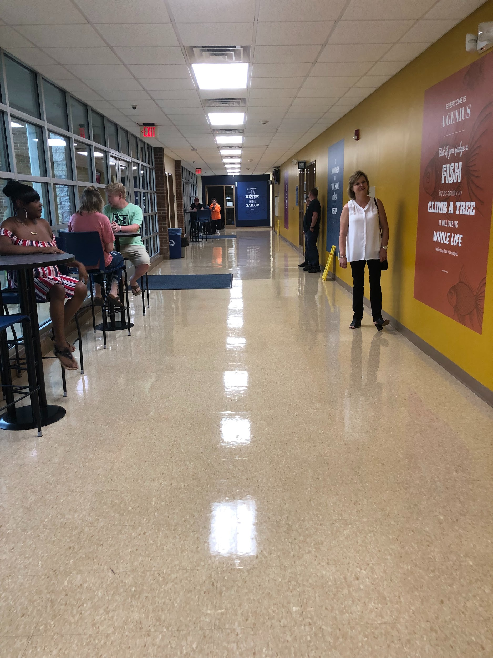
Welcome to the
College Transition Center
College Transition Center
Notes:
The atmosphere is welcoming with inspirational quotes sharing the message that students can succeed and that we value them at Davidson-Davie.

Slide 17
Inclusive Team Approach
Advising
Transition Center
Career Services
Admissions
Records
CCR

Slide 18
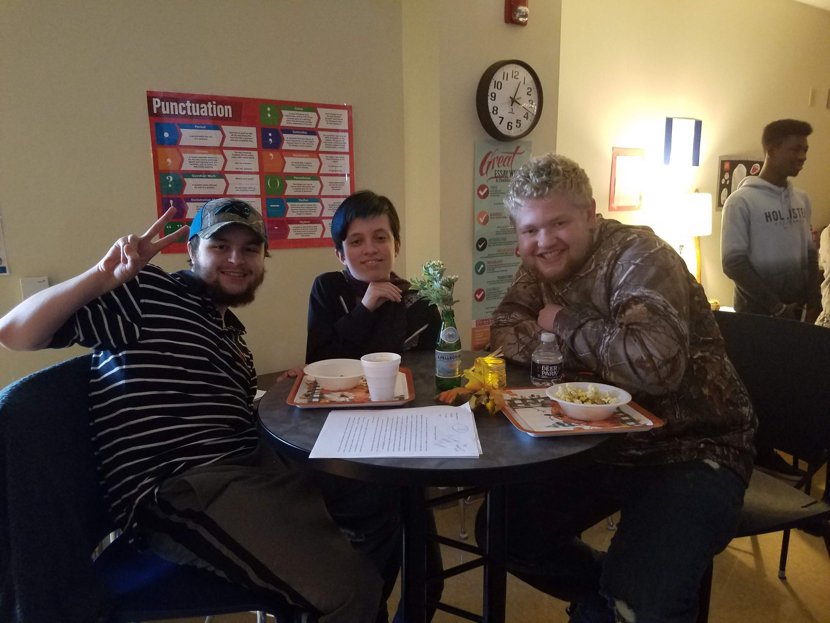
TYPICAL TRANSITION STUDENT
Graduated from high school within the past 10 years with a GPA of less than 2.2
High School Equivalency students
Adult High School students
Adults starting a new career
Students with special needs
Students who graduated more than ten years ago

Slide 20
Transition English and Transition Math offered through:
BSP 4002 Transition English
BSP 4003 Transition Math
ENG 002
MAT 003
Notes:
Our program offers Transition English and Math both in College and Career Readiness (BSP 4003 for math) and Curriculum (MAT 003). The options are seamless for our students because students receive the same instruction with the same expectations with caring and knowledgeable instructors who teach in both 403 and 003. The decision for our students is often based on their need for financial aid or flexible enrollment. We are meeting the needs for all students by offering our classes in both formats.

Slide 21
Why Choose Career READY?
Flexible Entry and Scheduling
Contextualized Learning focusing on specific pathways (WIOA)
Foundational skills with supportive instructors
Helps students develop “I can attitude”

Slide 22
Why Choose Career READY?
Does not require Financial Aid
No cost for the courseware
Allows students to transition to curriculum courses with no delay
Students can complete in “their time”

Slide 23
Why Choose Career READY?
Support for HSE students taking the HiSet or GED
Various modes of delivery (Face to Face, Virtual, Online)
4th Math and 4th English

Slide 24
Why Choose Curriculum?
Counts toward financial aid
Meets VA requirements
Appears on official transcript
Meets Early College requirements

Slide 25
WHAT STRATEGIES ARE WORKING FOR US?

Slide 26
MUST Change THE MINDSETS OF BOTH THE INSTRUCTORS & STUDENTS
MUST CHANGE THE RELATIONSHIP BETWEEN THE INSTRUCTORS & STUDENTS

Slide 27
DEVELOPING POSITIVE GROWTH MINDSETS

Slide 28
GROWTH MINDSET QUOTES
Notes:
https://www.sdiclarity.com/sdi-news/value-growth-mindset-culture/
A different quote is given to students each week and they are required to reflect on what the quote means to them. It doesn’t have to necessarily be about math. It can be about anything in their life. It makes them think outside the box.”

Slide 29
BUILDING STRONG RELATIONSHIPS
flyclipart.com
Notes:
We build these strong relationships by being honest and always keeping the lines of communication opened.

Slide 30
COMMUNICATION
Communication is to building
relationships with students. We communicate with
StarFish
Sign Up Genius
Remind
Google Forms
Muddiest Point
It’s extremely important to check on students when they are absent from class.
Notes:
https://www.barrow.k12.ga.us/schools/ahs/news/1678189/remind-communication-tool
https://www.signupgenius.com/

Slide 31
MONITORING STUDENT PROGRESS

Slide 32
STRATEGIES
Develop Growth Mindset with faculty and students.
Create Growth Mindset classrooms.
Identify the leaders in the class & empower them to help others.
Encourage study groups/sessions. Teams of student learners
Use Zoom Breakout rooms.
Build strong relationships with open communication.
Monitor students progress.
Celebrate a piece of student’s work and success.
Pacing/Expectations -- emphasize often!
Notes:
Celebrating a student’s success gives respect for their hard work.

Slide 33
STUDENT’S PERSPECTIVE

Slide 34
QUESTIONS
Notes:
If you have any questions, please type them in the chat box.

Slide 35
Jody Lawrence, M.S.Ed
Dean, Academic Support
Davidson-Davie Community College
jody_lawrence@davidsondavie.edu
Londa Pickett, M.S.Ed
Director, College Transition Center
Davidson-Davie Community College
londa_pickett@davidsondavie.edu
Lisa Kraft, M.A.Ed
Director, College and Career Readiness
Davidson-Davie Community College
lisa_kraft@davidsondavie.edu
Jill Storey
Director, College and Career Readiness
Davidson-Davie Community College
jill_storey@davidsondavie.edu
Sterling Charles, B.S.
Lead Transition Math Faculty/
Instructional Staff
Davidson-Davie Community College
sterling_charles@davidsondavie.edu
Courtney Wilson
Online Instructor
Davidson-Davie Community College
courtney_wilson@davidsondavie.edu

Slide 36
Application Steps to Enroll

Slide 37
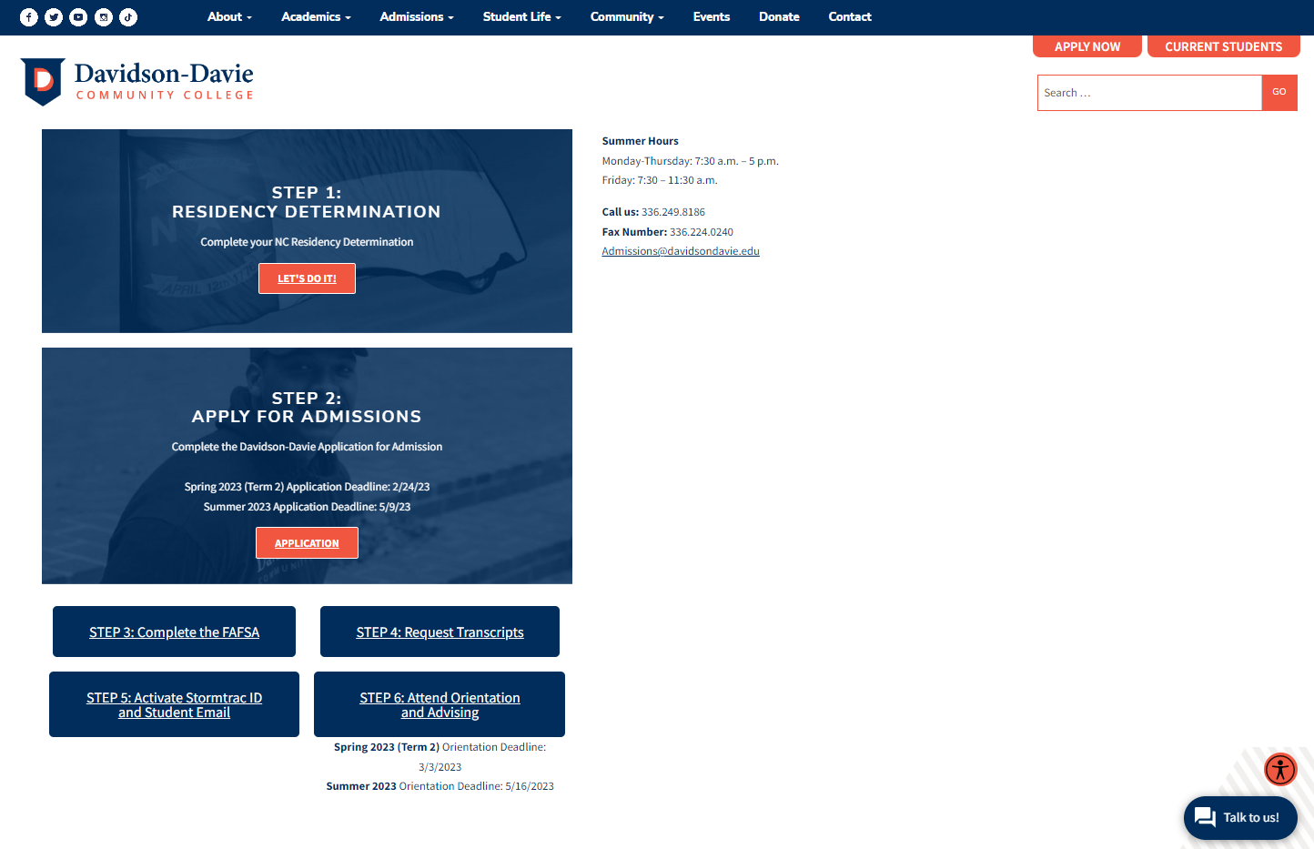
Your Next Steps
https://www.davidsondavie.edu/admissions/how-to-apply
Complete Residency Determination Services
Complete Online Application
Submit the FAFSA
Request Transcripts
Activate your Stormtrac & Student Email
Attend Orientation & Meet with Advising
Start at DDCC!

Slide 38
Complete RDS
Residency Determination Services www.ncresidency.org
In-state or Out-of-state
Residency Certification Number (RCN)
Students have 25 calendar days to complete the online residency.

Slide 39
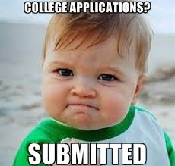
2. Complete the application
Spring ’23, Summer ’23, and Fall ’23
applications are LIVE!
Apply: www.cfnc.org
Special criteria competitive programs:
Nursing Programs (deadlines 1/27 & 2/24)
Dental Assisting (deadline 4/3)
Surgical Technology (updated deadline 2/24)
Zoo & Aquarium Science (deadline 4/3)
When in doubt, ask Admissions!
Notes:
We are an open enrollment school. You can complete the application at any time to enroll with us, however we recommend that you complete the enrollment process at least 2 weeks in advance of the start of the term so that you will be set up for success.
This is for all programs except for our programs with special criteria that are competitive and have a separate application processes. Most of these programs are Fall entry only and the deadlines have passed for Fall 21 enrollment. In addition, there is an application specific to students interested in the College and Career Promise (dual enrollment program as well). For more information either visit our website or contact admissions.
Through a collaboration with North Carolina A&T State University, the RIBN is a nursing program option to prepare qualified students for the professional role of registered nurse at the entry level. Students admitted to this program through the competitive entry process take three years of nursing education at Davidson-Davie while also taking one course each semester at NC A&T State.

Slide 40
3. Submit the FAFSA
What Is It?
Free Application for Federal Student Aid (FAFSA)
A standardized form used to collect demographic and financial information about the student and their family
Completed each year
Available in English and Spanish

Slide 41
FAFSA
Who Can File?
Enrolled in an eligible degree or certificate program
Have a valid Social Security number
U.S. citizen or national
U.S. permanent resident
Battered Immigrant Status
Arrival-Departure Record (I-94)
Refugee
Asylum Granted
Cuban-Haitian Entrant
Conditional Entrant
Parolee
T-visa or a parent with a T-1 visa

Slide 42
FAFSA
What the Student Needs
What the Parent Needs
FSA ID
Full name as it appears on Social Security card
SSN or Alien Registration Number
Federal tax returns or record of income earned
Bank statements and records of investments (if applicable)
Records of untaxed income (if applicable)
FSA ID
SSN, Alien Registration Number, or 000-00-0000
Federal tax returns or record of income earned
Bank statements and records of investments (if applicable)
Records of untaxed income (if applicable)

Slide 43
FAFSA
When & How to File
2022 – 2023 FAFSA available now
2023 – 2024 FAFSA became available on October 1
FAFSA website: fafsa.gov

Slide 44
Types of Financial Aid
Federal Grants
Federal Pell Grant
Federal Supplemental Education Opportunity Grant
NC Grants
NC Community College Grant
NC Education Lottery Scholarship
Federal Loans
Federal Direct Student Loan
Federal Direct Parent PLUS Loan
Federal Work-Study
Davidson-Davie Foundation Scholarships

Slide 45
Financial Aid Timeline
Spring 2023
2022 – 2023 FAFSA
Financial Aid Offer sent upon acceptance and receipt of the FAFSA
Summer 2023
2022 – 2023 FAFSA
Financial Aid Offer sent upon acceptance and receipt of the FAFSA
Fall 2023
2023 – 2024 FAFSA
Financial Aid Offer sent in May 2023
Please respond to requests for documentation as quickly as possible

Slide 46
Tuition and Fees
Cost per Credit Hour
NC Resident (In-State): $76
Non-Resident (Out-of-State): $268
Credit Hours | NC Resident Tuition and Fees | Non-Resident Tuition and Fees
3 | $279.25 | $855.25
6 | $507.25 | $1,659.25
9 | $748.25 | $2,476.25
12 | $989.25 | $3,293.25
16 or more | $1,293.25 | $4,365.25

Slide 47
Money Matters
*data based on in-state tuition and fee rates for 2019-2020 academic year.

Slide 48
4. Request transcripts
High school
Can help determine course placement based on your unweighted GPA if you’ve graduated from high school in the last 10 years
Needed for some special criteria admissions applications & program eligibility
Taken any college credit outside of DDCC?
In order to evaluate and apply transfer credits, the college transcript MUST be official!
Beneficial for some special criteria admissions applications & program eligibility
Notes:
We encourage all students to submit their transcripts to us. While we don’t require transcripts for general admissions, some programs do. High school transcripts can be unofficial, but if you have taken any college-level courses, we will need your official college transcript to evaluate and verify your courses for transfer credit.

Slide 49
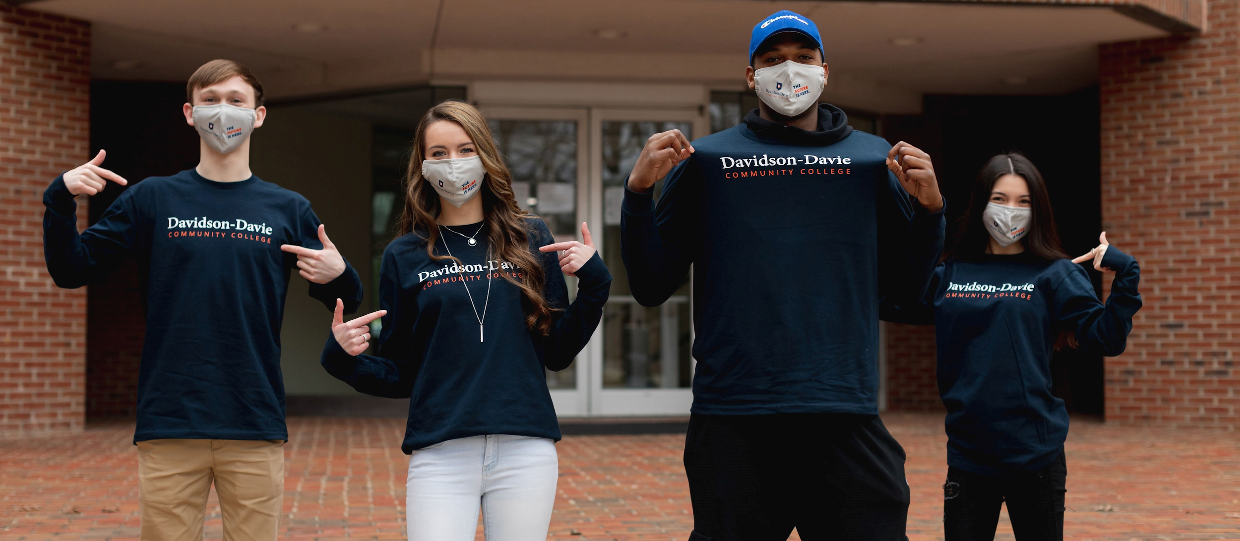
6. Complete Orientation & Advising
✔ Complete New Student Orientation
Online session available 24/7 to help you with academic planning, understanding program
requirements, how to prepare for advising appointments, and learning about resources
✔ Undecided? Meet with Career
✔ Meet with your advisor
to create your class schedule &
get registered for classes
✔ Start at Davidson-Davie
Community College!
Notes:
So you’ve completed your application and RDS, and submitted your fafsa. Now you’re admitted, so what’s next?
Complete your online New Student Orientation (NSO)
If you are undecided on your program of study, you will have the opportunity to meet with one of our career counselors.
After Orientation, you will meet with you advisor, create your course schedule, register for classes, and then start at Davidson-Davie!

Slide 50
2023 Enrollment Schedule
Spring 2023 Term 2 Application Date: February 24th
Complete Orientation by March 3rd
Start Classes on March 13th
Summer 2023 Application Date: May 9th
Complete Orientation by May 16th
Start Classes on May 24th or June 5th
Fall 2023 Application Date: July 28th
Complete Orientation by August 4th
Start Classes on August 14th
Notes:
Our upcoming terms include Summer with the start date of June 7, and Fall 1st 8 weeks, with the start date of August 16.

Slide 51
Contact Us!
Davidson Campus
Coordinator, Special Admissions and Campus Outreach
Brooklyn Edwards
Mendenhall Building, 109
Brooklyn_edwards@davidsondavie.edu
336.249.8186, ext. #6124
Davidson Campus
College Recruiter & Admissions Counselor
William Pass
Mendenhall Building, 110
william_pass@davidsondavie.edu
336.249.8186, ext. #6416
Davidson Campus
Director, Recruitment & Admissions
Cailin Asip
Mendenhall Building, 108
cailin_asip@davidsondavie.edu
336.249.8186, ext. #6122
Davie Campus
Director
Sandra Porter
Administrative Building
sandra_porter@davidsondavie.edu
336.249.8186, ext. #4853

Slide 52
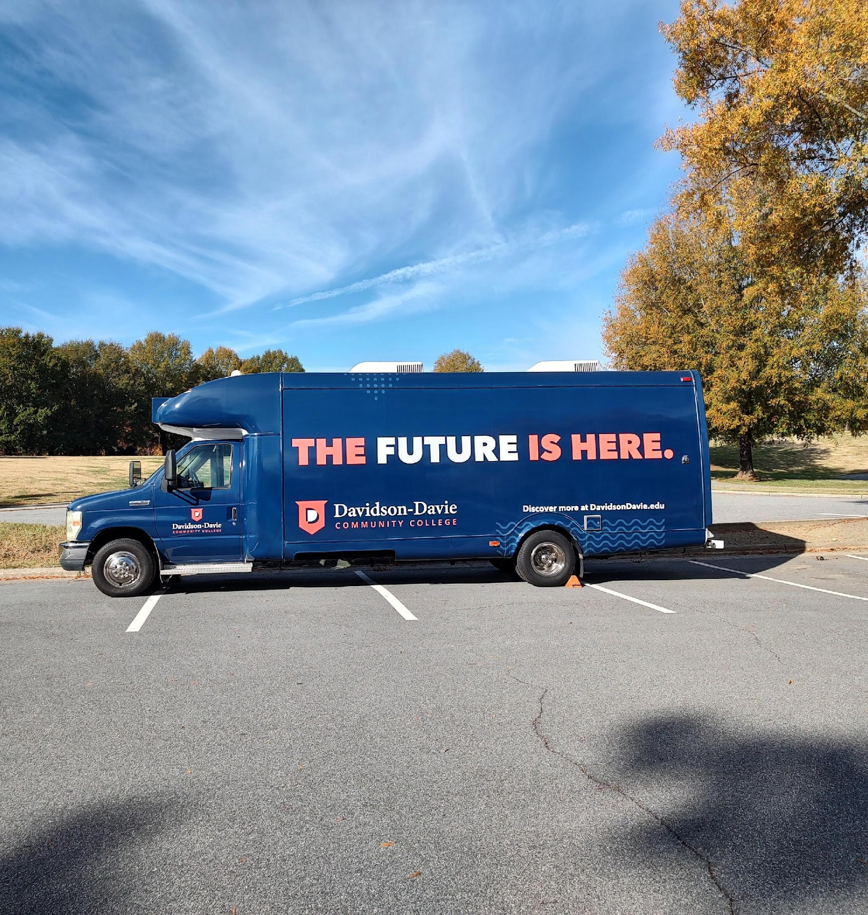
Enrollment Unit
Enrollment Unit

Slide 53
Inspirational Quote-1

Slide 54
Inspirational Quote-2

